Slide 1
Voronoi Diagram

Slide 2

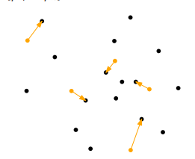
POST OFFICE PROBLEM

Slide 3
INTRODUCTION
A Voronoi diagram is a simple concept, and it's based on the minimal distance needed to reach a landmark.
One of the first applications of a Voronoi diagram was by Dr John Snow, a prominent London physician.
Voronoi Diagram: On a plane, for a set of sites (points in that 2D space with similar properties) the Voronoi diagram partitions the space based on the minimal distance to each site.

Slide 4
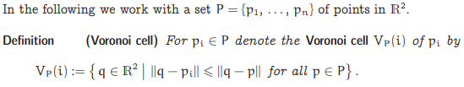

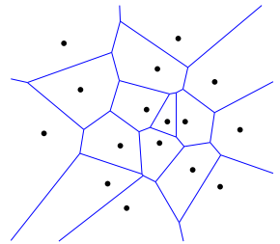
MATHEMATICAL DEFINITION

Slide 5
CONSTRUCTION
Naive Algorithm

Slide 6
CONSTRUCTION
Fortune’s Algorithm

Slide 7
APPLICATIONS
Anthropology and Archeology -- Identify the parts of a region under the influence of different neolithic clans, chiefdoms, ceremonial centers, or hill forts.
Marketing -- Model market of US metropolitan areas; market area extending down to individual retail stores
Robotics -- Path planning in the presence of obstacles
Meteorology -- Estimate regional rainfall averages, given data at discrete rain gauges
Statistics and Data Analysis -- Analyze statistical clustering ("Natural neighbors" interpolation)
Zoology -- Model and analyze the territories of animals

Slide 8
ADVANTAGES
it runs in optimal time
it is reasonable to implement
we need not store the entire diagram if we can use it as we sweep over it

Slide 9
DISADVANTAGES
it suffices to draw the diagram, but it does not contain the proximity information.

Slide 10
TOOLS
Python
R
Java
Tableau
Plotly

Slide 11
THANK YOU !

